Slide 1

Airbnb Investment Analysis: Top Countries for Profitable Hosting
Saim Mahmud
CIS 512 (Introduction to Data Science)
11/19/2025

Slide 2


Slide 3
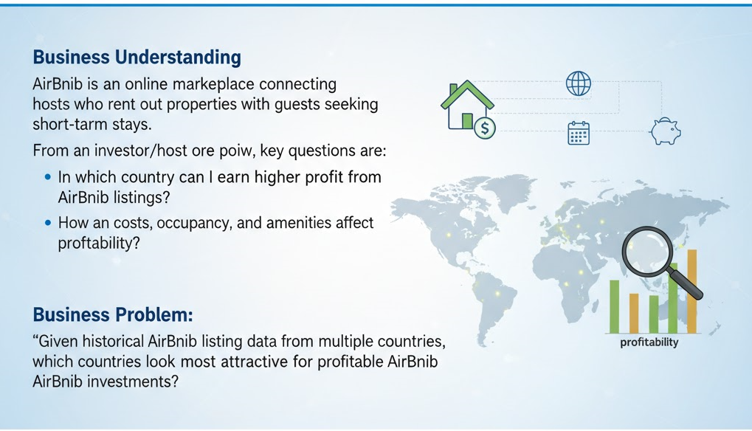
Business overview

Slide 4
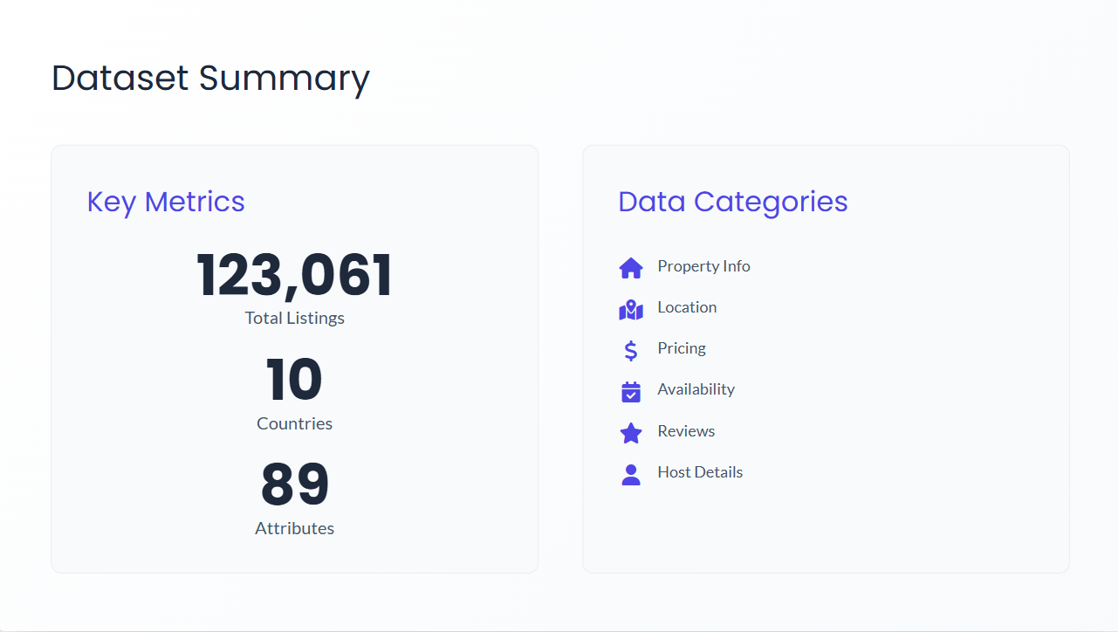

Slide 5
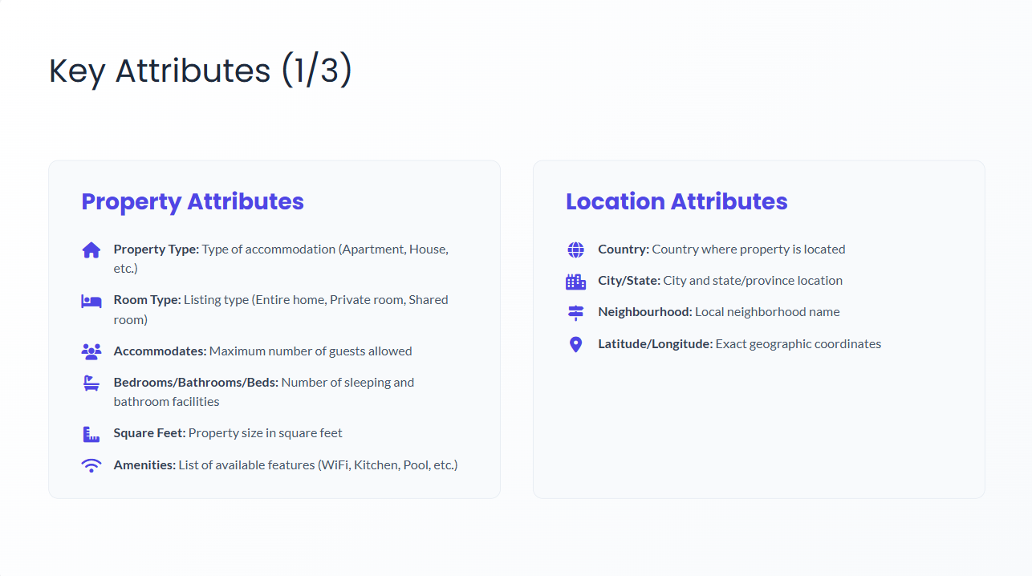

Slide 6
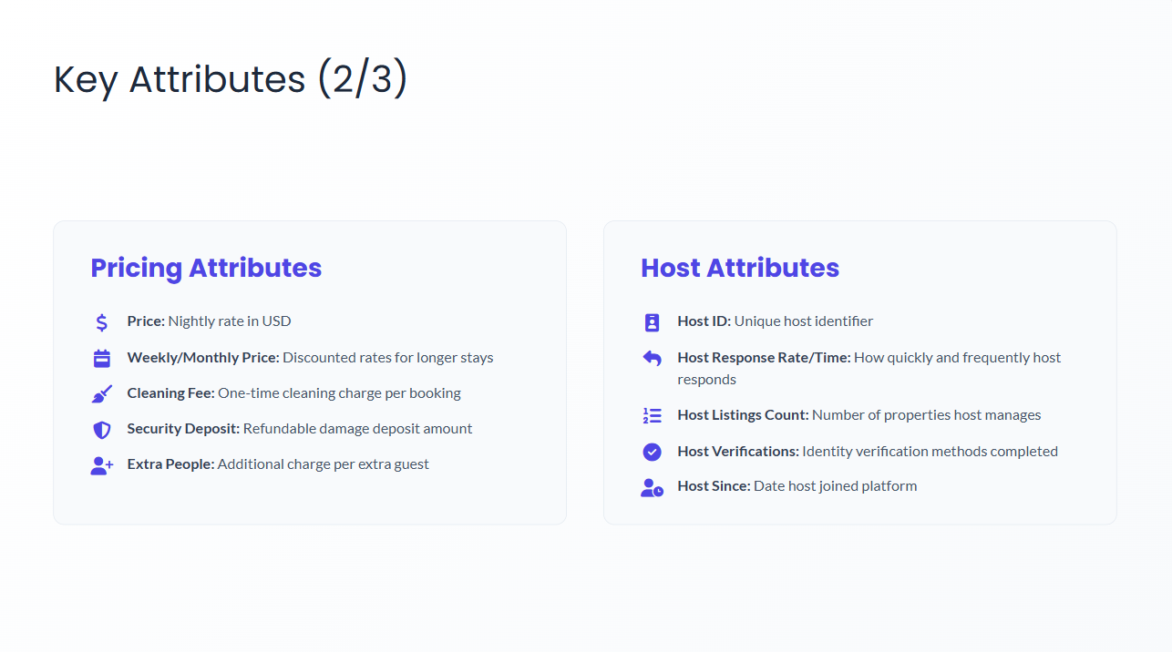

Slide 7
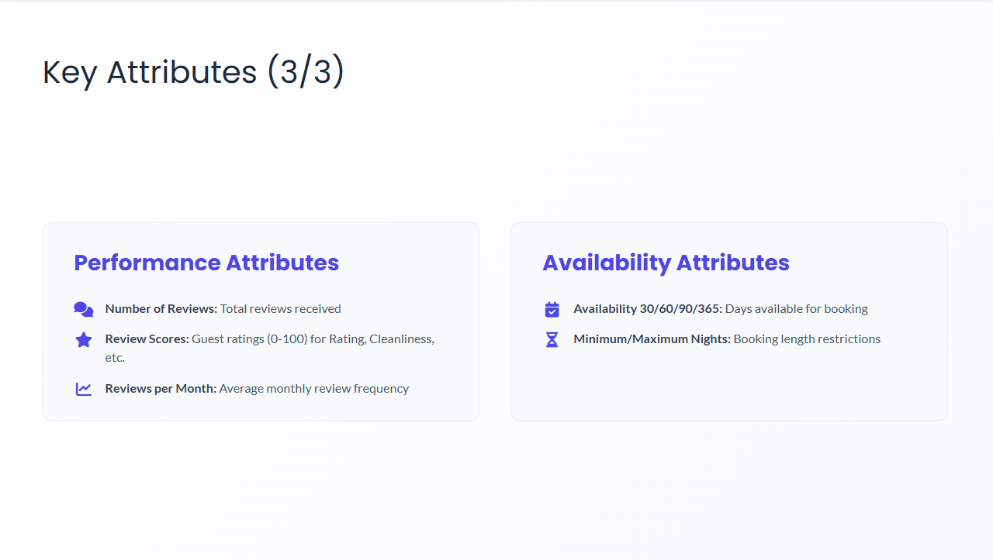

Slide 8


Slide 9
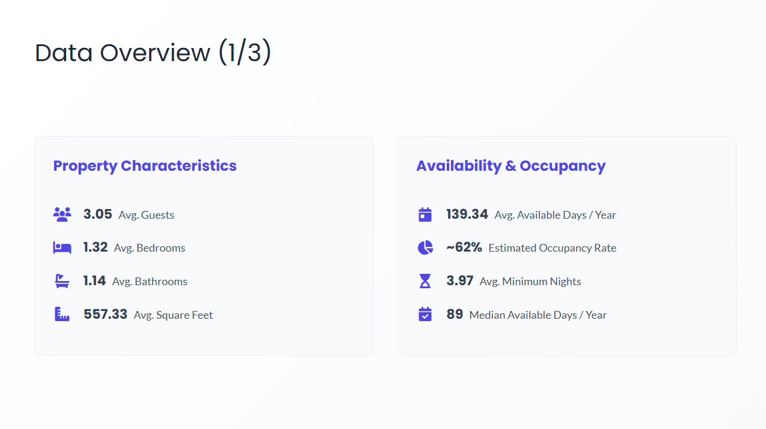

Slide 10
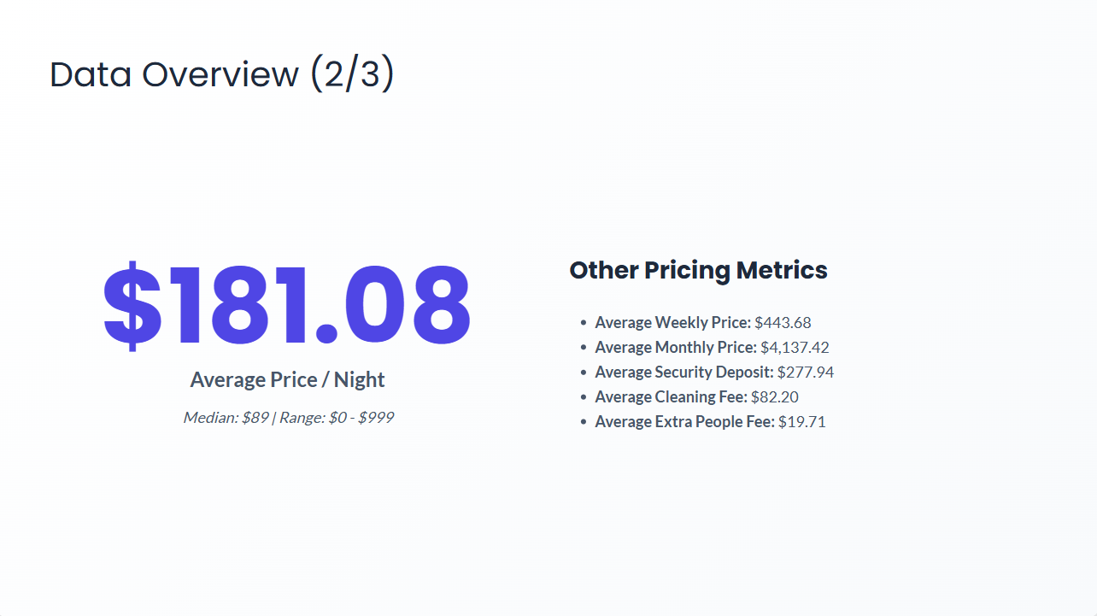

Slide 11
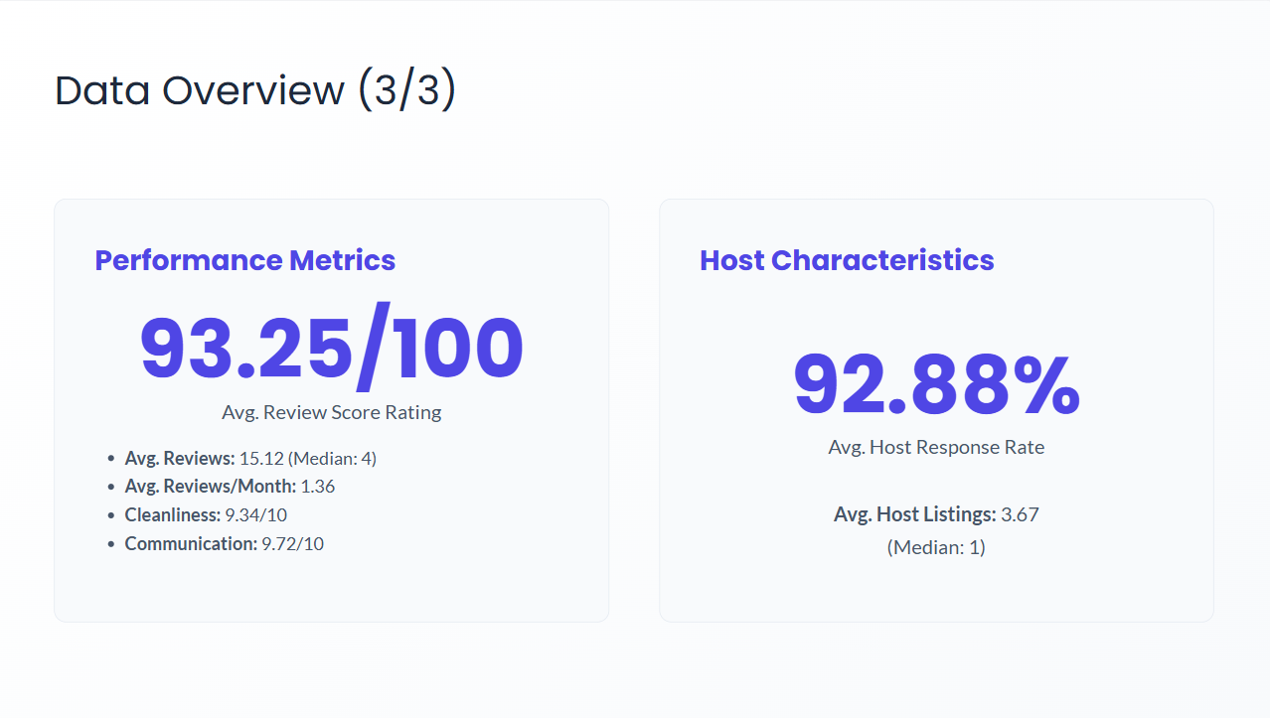

Slide 12
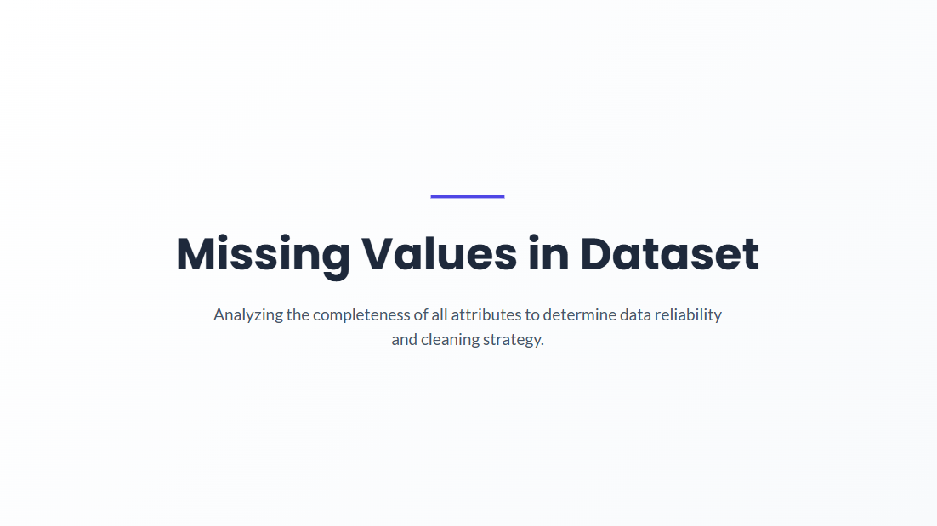

Slide 13
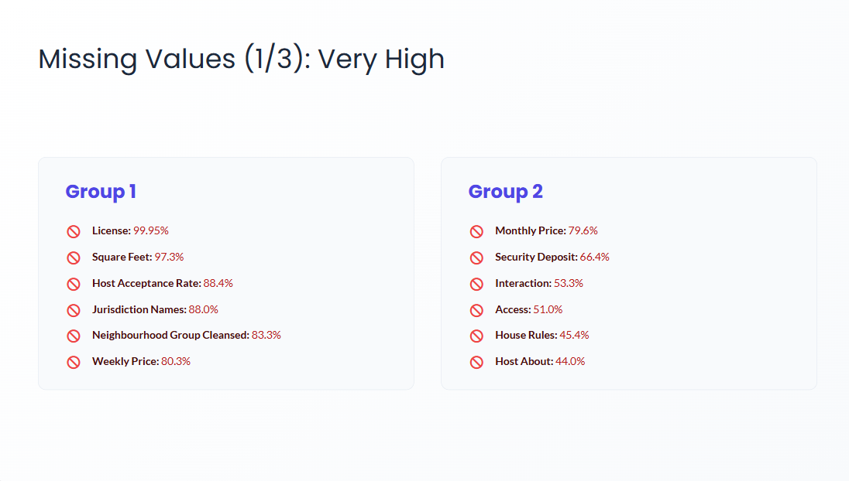

Slide 14
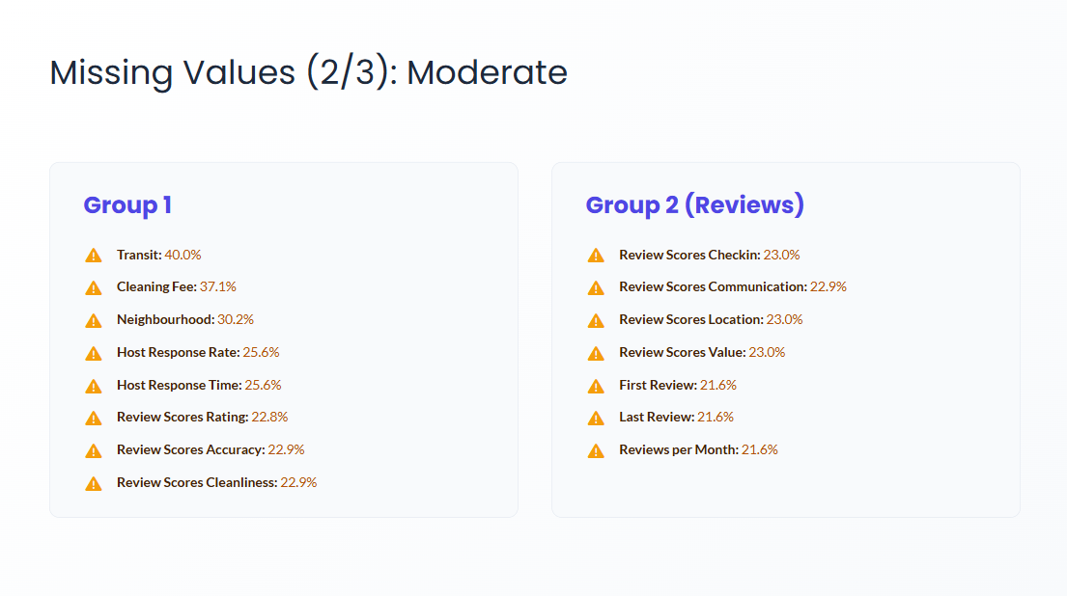

Slide 15
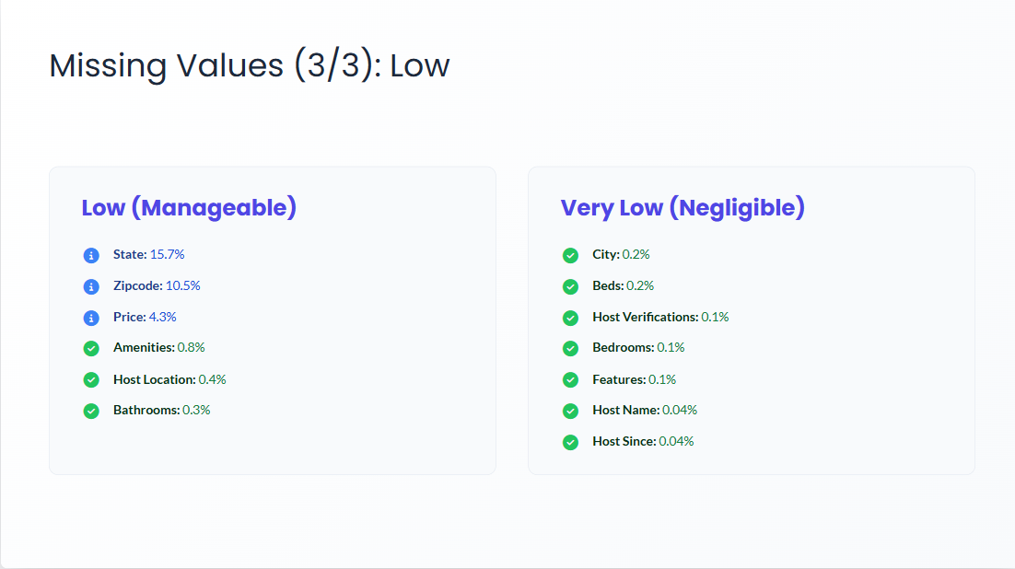

Slide 16
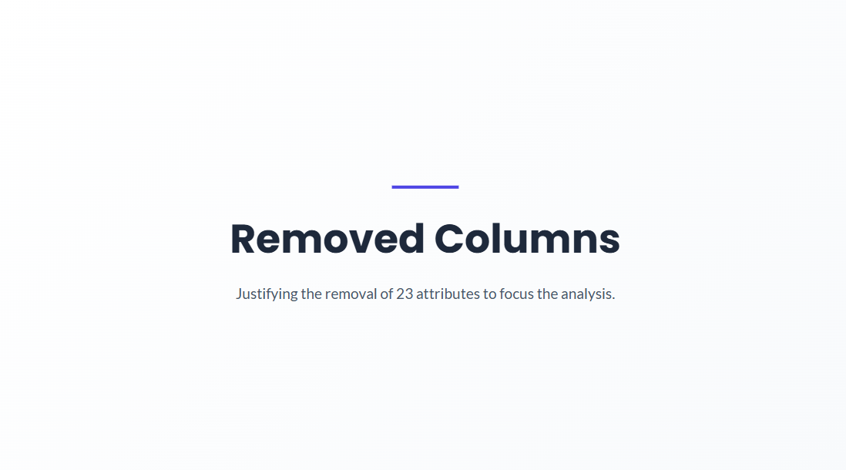

Slide 17
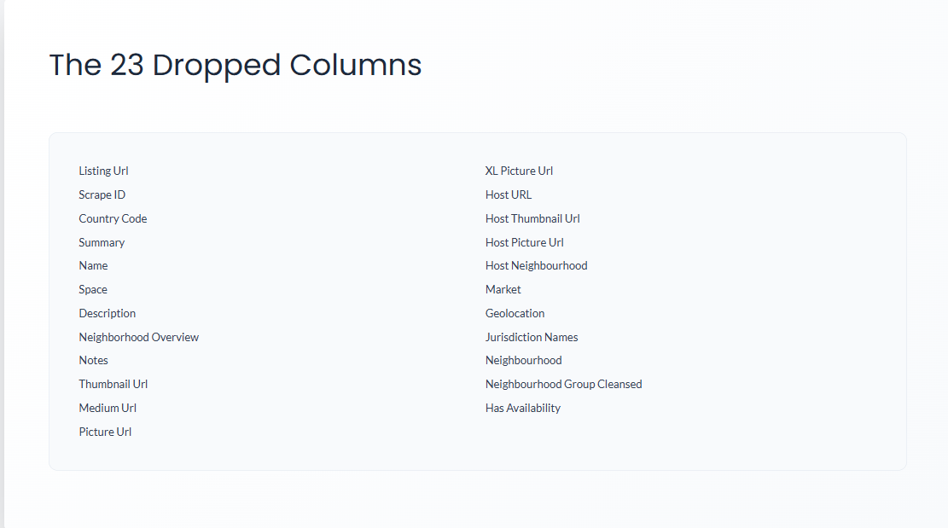

Slide 18
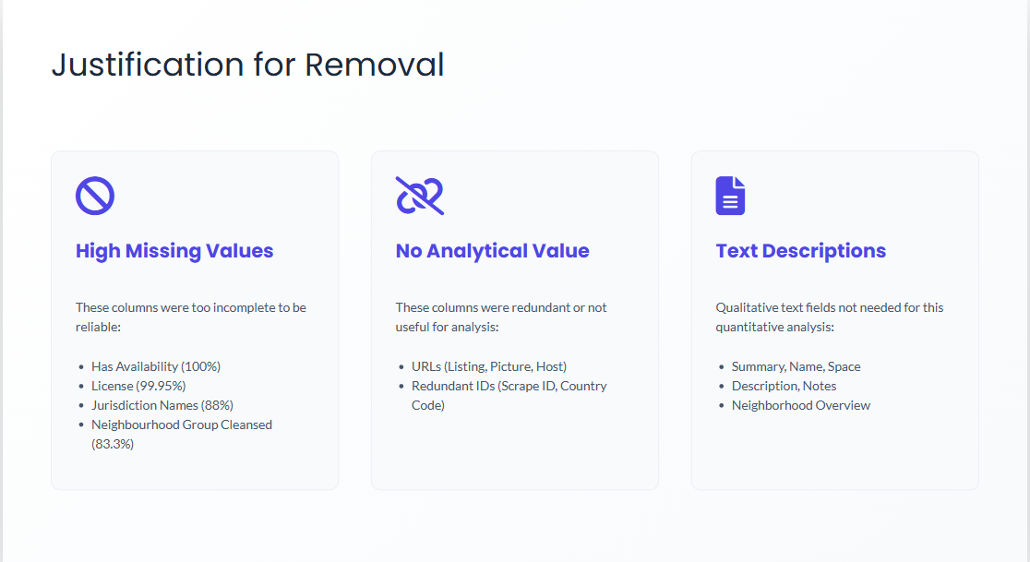

Slide 19


Slide 20
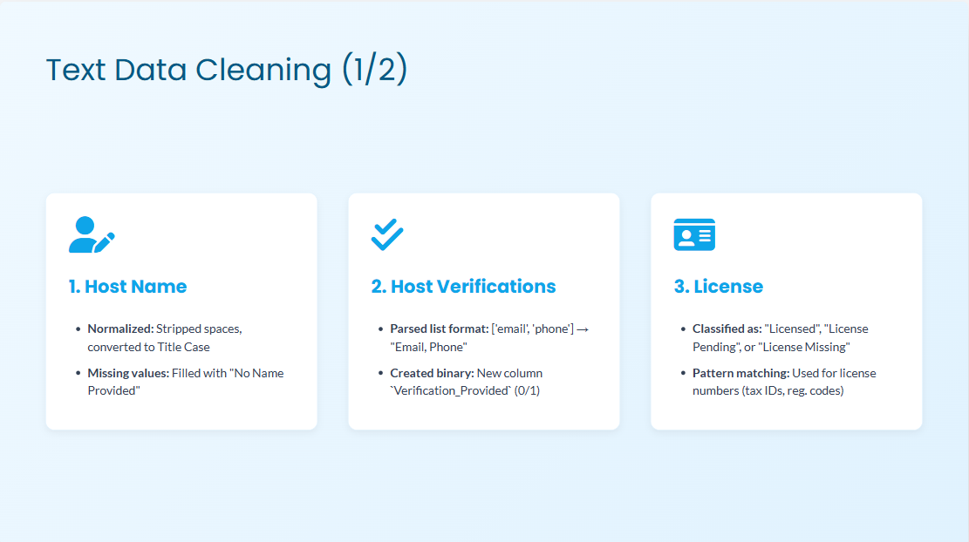

Slide 21
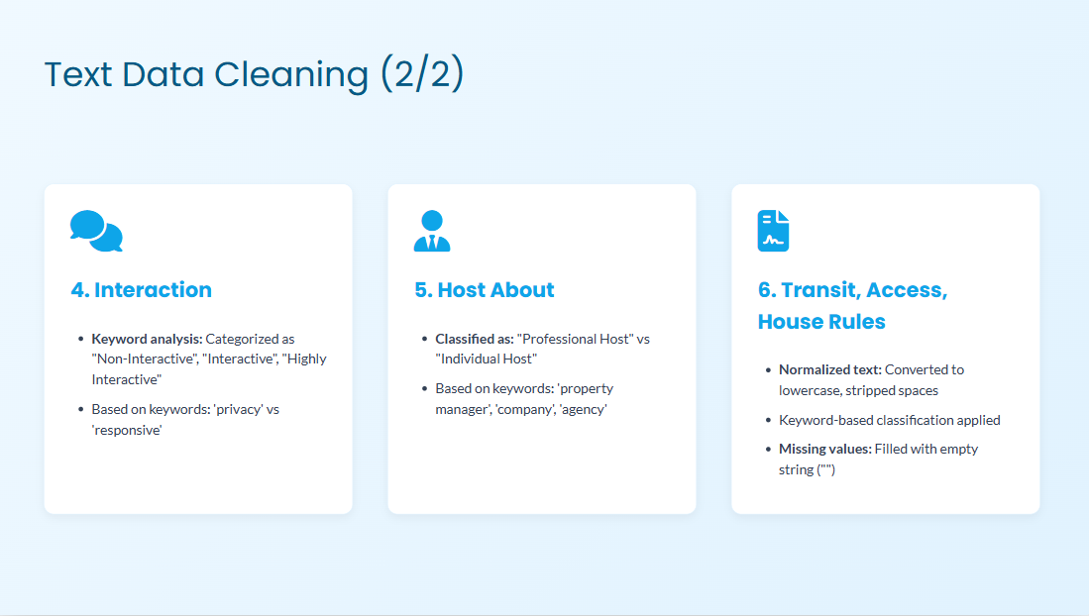

Slide 22
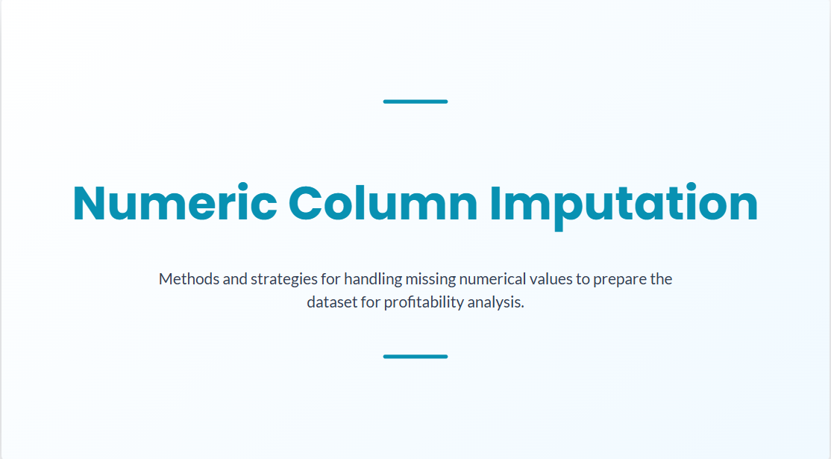

Slide 23
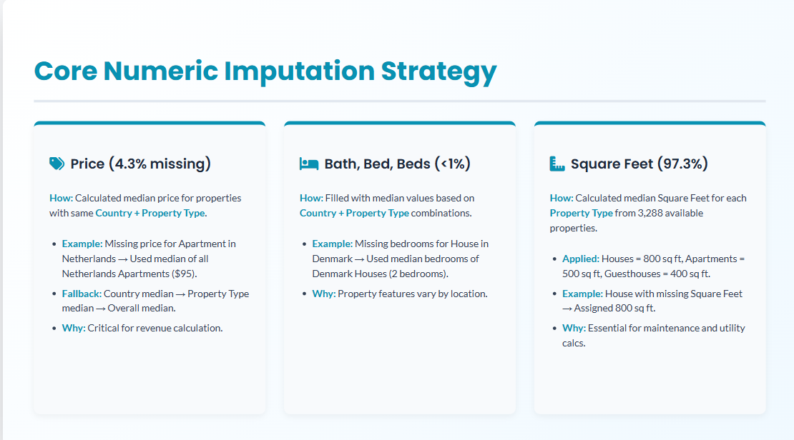

Slide 24
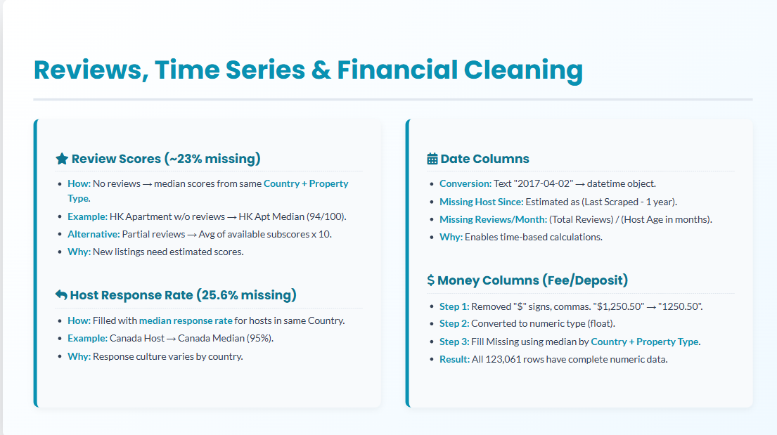

Slide 25


Slide 26
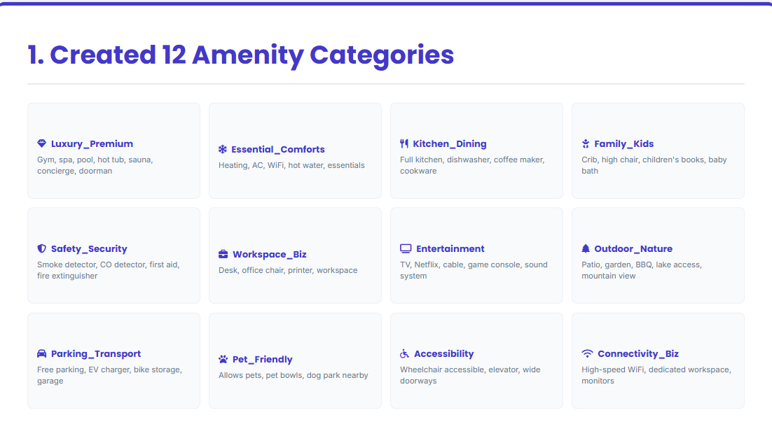

Slide 27
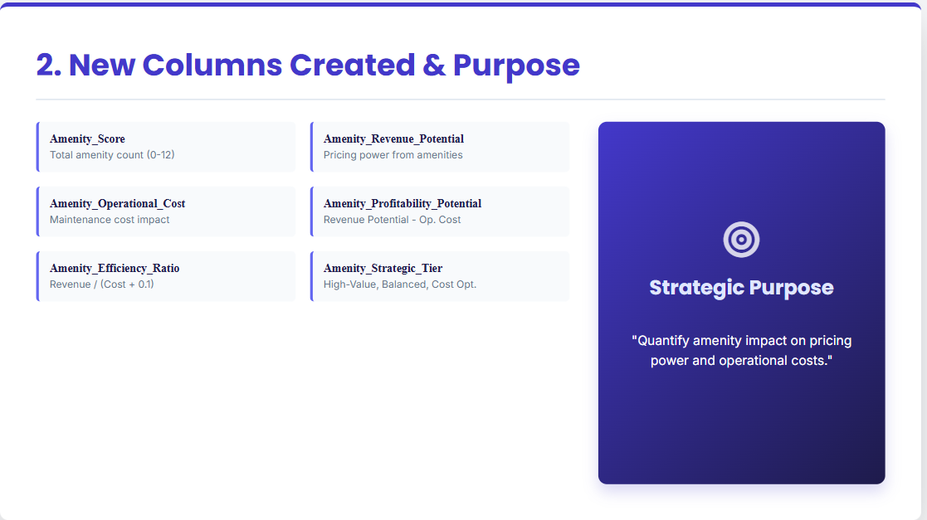

Slide 28
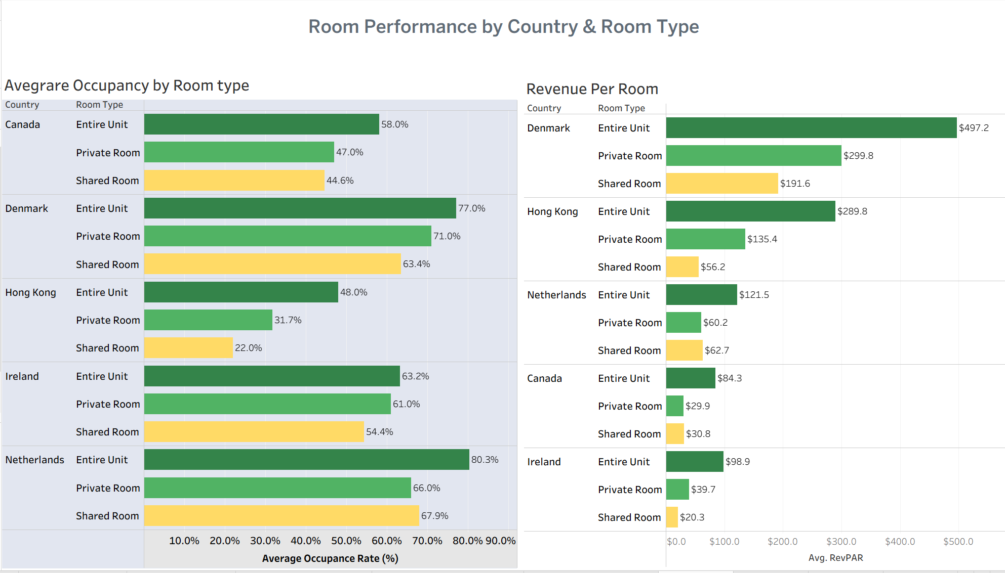
Notes:
shows room performance through occupancy rates and revenue per available room. We calculated occupancy from booking data and RevPAR by multiplying price times occupancy. Denmark leads with 77% occupancy and $497 revenue per room, six times higher than Canada. Notably, Hong Kong generates strong revenue at $290 despite lower occupancy, demonstrating that premium pricing drives profitability more than booking frequency alone.“

Slide 29
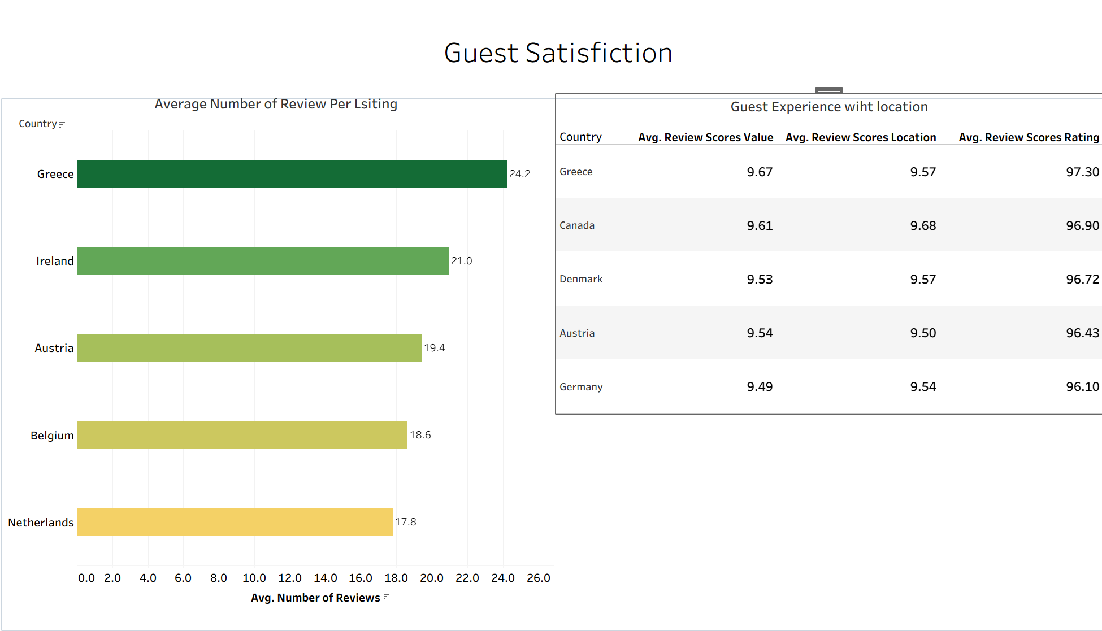
Notes:
The left side shows how many reviews each property gets on average - Greece is highest with about 24 reviews per listing. On the right, we've got the actual review scores for value, location, and overall rating. every country scores between 96 and 97 percent. Denmark and Canada?, Pretty much identical scores. So this tells us that operational quality and service standards are consistent across all these markets

Slide 30
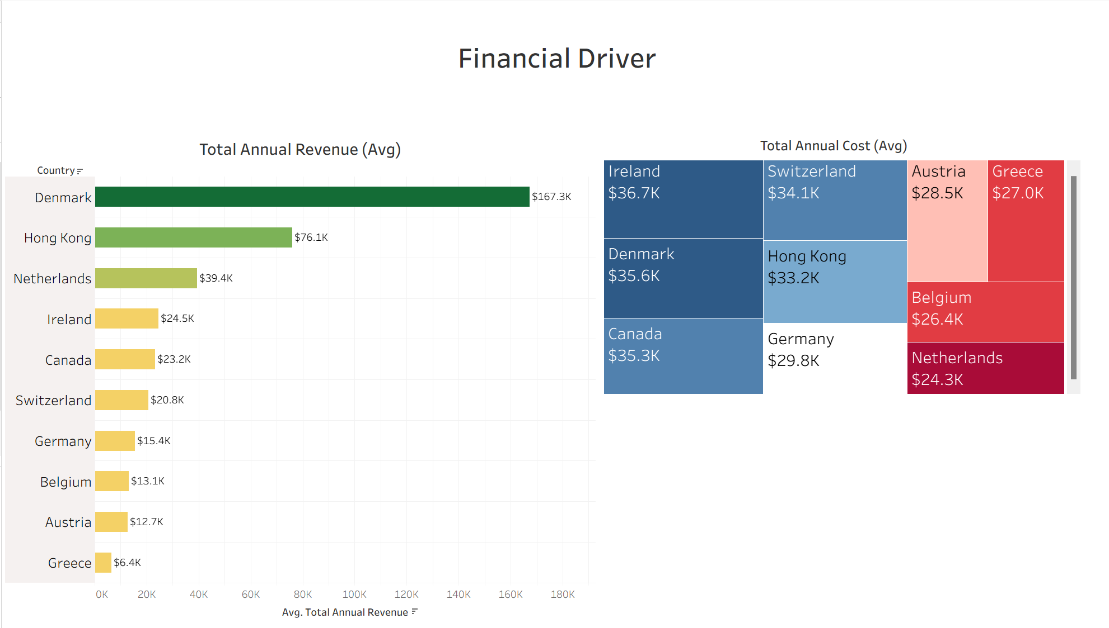
Notes:
this is the financial side. On the left here, you can see average annual revenue per property. Denmark is just crushing it at $167,000 a year. Hong Kong's doing pretty well at $76,000, right side - this is the cost treemap.operating costs are similar across markets, ranging from $24,000 to $37,000. Denmark and Canada both cost around $35,000 to operate, but Denmark earns seven times more revenue

Slide 31
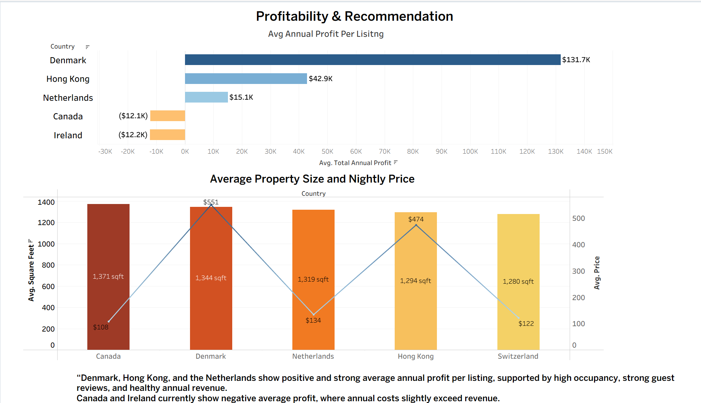
Notes:
Dashboard 4 shows our final profitability results. Top chart: Denmark makes $132,000 profit per property, Hong Kong $43,000, Netherlands $15,000. Canada and Ireland both lose about $12,000.
Bottom chart explains why. Properties are similar sizes around 1,300 square feet, but Denmark charges $551 per night while Canada charges $108. Five times the price for the same size property.
Recommendation: invest in Denmark, Hong Kong, and Netherlands. Premium pricing drives profitability."

Slide 32


Slide 33
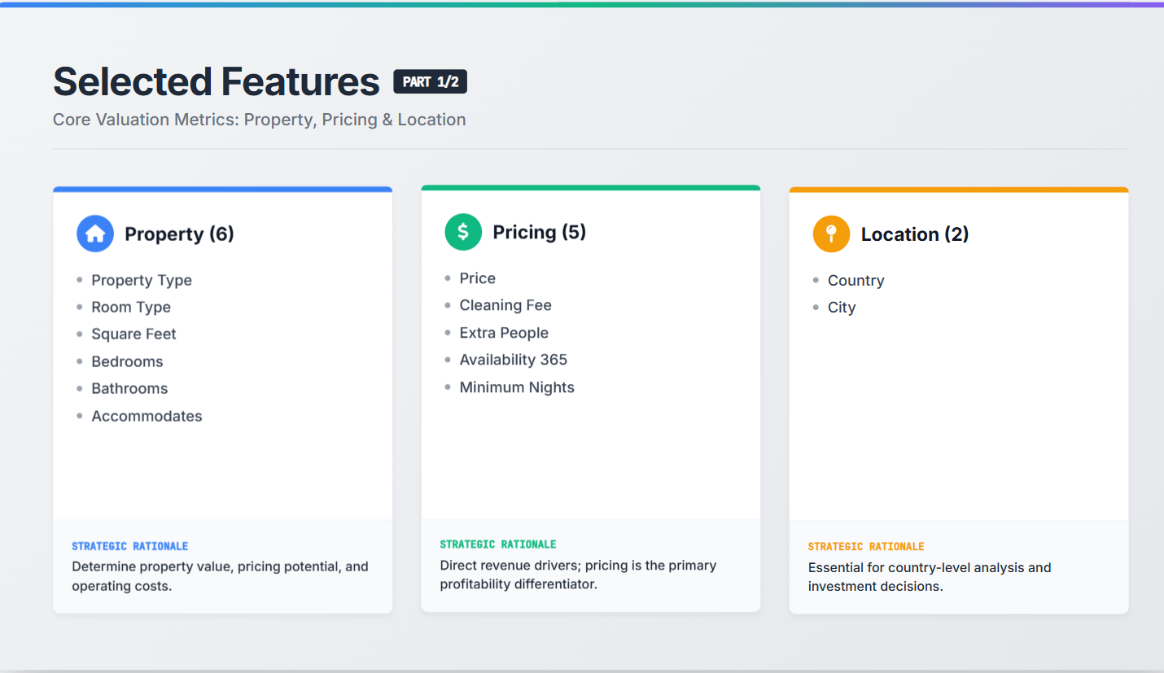

Slide 34
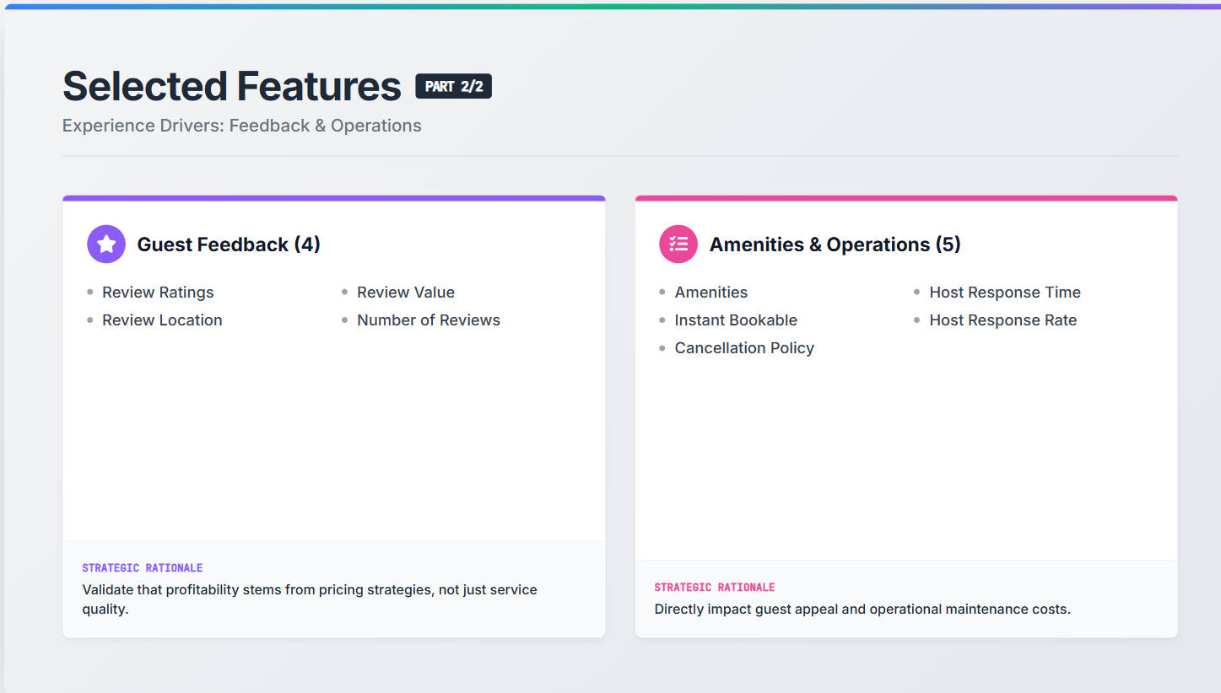

Slide 35


